Slide 1
ECONOMIC IMPORTANCE OF BACTERIA

Slide 2
AGRICULTURE
INDUSTRY

Slide 3
Title and Content Layout with List
Agriculture
Beneficial Activities
Harmful Activities
Industry
Antibiotics Production
Fermentation
Retting Of Fibres

Slide 4
AGRICULTURE
BENEFICIAL ACTIVITY
HARMFUL ACTIVITY

Slide 5
BENEFICIAL ACTIVITY

Slide 6
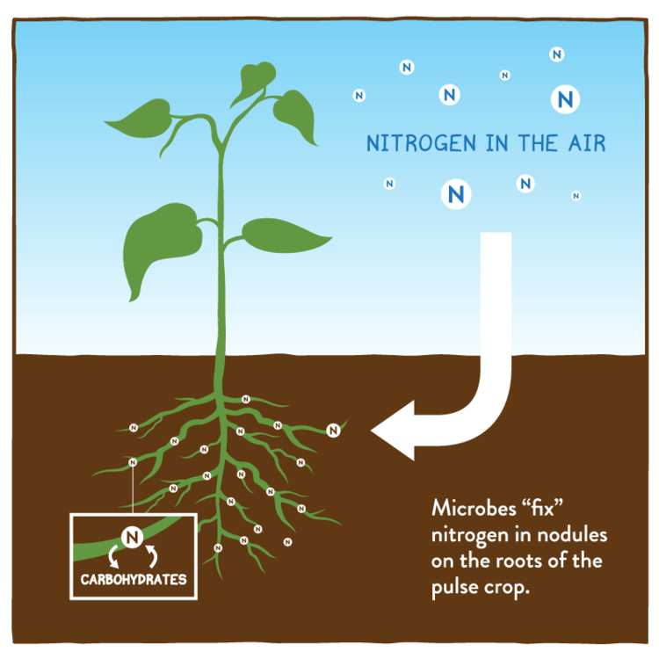
SOIL FERTILITY
Nitrogen Fixation
Azotobacter
Rhizobium

Slide 7
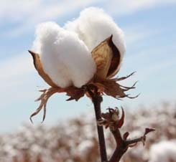
PEST CONTROL
BT Cotton
Genetically Modified Crop
Bascillus thuringiensis

Slide 8
HARMFUL ACTIVITY

Slide 9
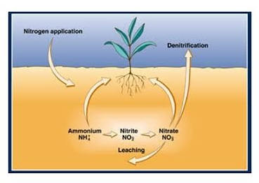
REDUCE SOIL FERTILITY
Nitrate Free N2
Micrococcus denitrificans

Slide 10
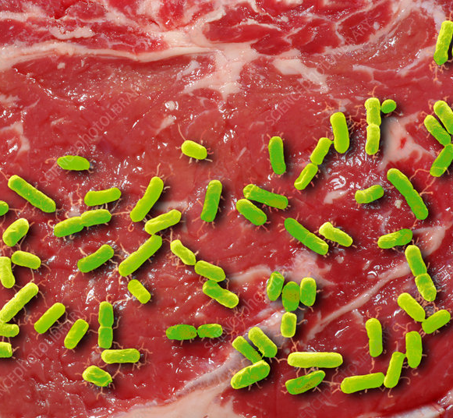
SPOILAGE OF FOOD STUFF
Meat E.coli
Fish Pseudomonas sp.
Food Poisoning Salmonella sp.

